Slide 1
EduAsses360 – MCQ Exam
Project by Nahidul Islam Shakin
Id : 18CSE246
Project Supervisor
Sakifa Aktar
Assistant Professor,
CSE, BSMRSTU

Slide 2
Welcome to my presentation

Slide 3
INTRODUCTION
Common Challenges in Exam Preparation :
Lack of personalized feedback and analysis after exams.
Difficulty in finding relevant syllabus, guides and notes.
Inefficient time management due to scattered study resources.
Overwhelmed by the abundance of information.
Limited access to effective practice exams.

Slide 4
INTRODUCTION
EduAssess360 Solution :
Integrated platform providing syllabus, notes.
Personalized study recommendations.
AI-driven insights to identify and improve weak areas.
Streamlined access to category-wise exams and tailored study materials.

Slide 5
KEY FEATURES
MCQ and Written Exams : Exams with AI evaluation and feedback.
Category-Wise Exam System : Different levels like SSC, HSC, Undergraduate, Job exam.
AI-Driven Notes and Suggestions : Personalized content based on exam performance.
Reward System : Points for good performance, which can be converted to unlock paid features.
Subscription System : Paid exams, notes, and other resources.
Teacher Panel : Allows teachers to set questions, get feedback, and improve question quality.
Admin Panel : Controls question permissions, point distribution, and more.

Slide 6
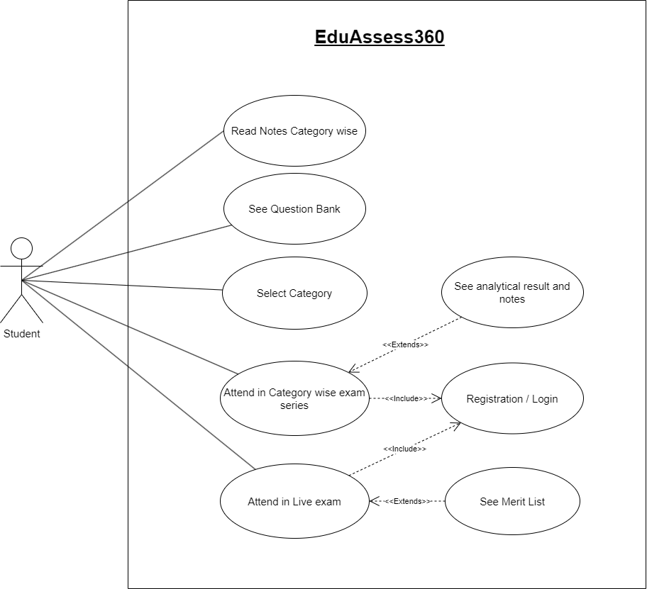
User Panel Use Case Diagram

Slide 7
Key Actions in the User Panel
Read Notes Category-Wise
Access study notes organized by specific exam categories.
See Question Bank
Browse and practice with a comprehensive question bank.
Select Category
Choose the exam category for targeted content.
Attend in Category-Wise Exam Series
Participate in a series of practice exams tailored to your category.

Slide 8
Key Actions in the User Panel
Attend in Live Exam
Take real-time, live exams to simulate the actual test environment.
See Analytical Result and Notes
Get detailed performance analysis and study recommendations.
See Merit List
View rankings and compare performance with peers.
Registration/Login
Register or log in to access personalized features.

Slide 9
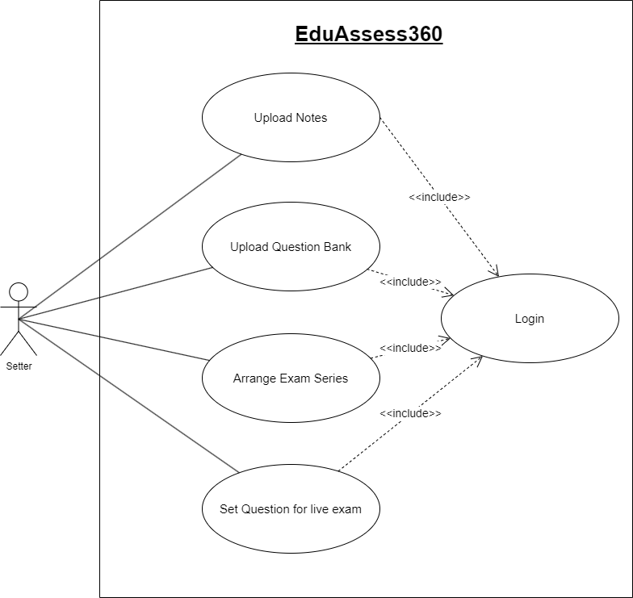
Setter Panel Use Case Diagram

